Slide 1
Intro to Git

Slide 2
What is Git?
Version control (VC) / Configuration Management (CM)
What is version control?
Automated way of tracking changes to files
Allows you to revert to a previous version
Can show you what changes were made in a particular version

Slide 3
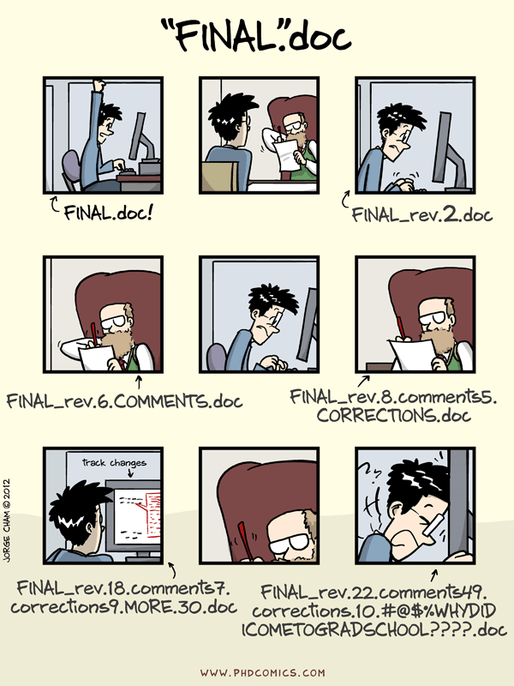
What is Git?

Slide 4
Git Basics
Two of the central concepts in git are repositories and commits
Repositories are groups of files that we want to VC together
Under a single parent directory
One repository might be the files for one project, one software application, etc.

Slide 5
Git Basics
Commits are “snapshots” of a repository
Commits contain all the data in the repository, as well as metadata
Commits can be checked out
Replaces the files in your repo directory with the versions from that commit
Metadata includes:
Name & email of the committer
Date & time of commit
Comments
Parent commit or commits
Commit ID

Slide 6
Git Basics
Commit ID identifies commit
Actually a hash of all the data in the repo
Looks like: ca82a6dff817ec66f44342007202690a93763949
160-bit number, or 40 hex characters
For convenience, commits are often referred to (by people) using just a few characters at the start of the hash

Slide 7
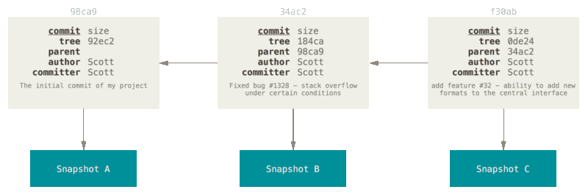
Git Basics
All commits (except the first one) must have at least one parent

Slide 8
Git Basics
Note that commit author, timestamp, etc. is just input by user
Structural information, however (commit IDs, parentage) is trustworthy
Because the parentage is based on commit IDs, you can’t sneakily alter a past commit
Commits can be verified
Checkout the commit
Hash the directory
Compare the hashes

Slide 9
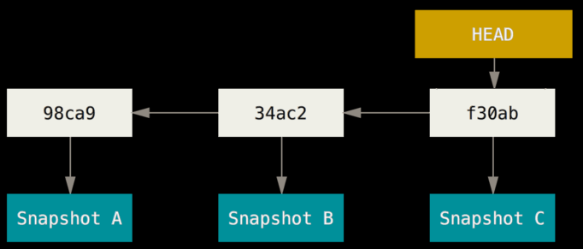
Git Basics
A repo has a label, or pointer called “HEAD”
This identifies which commit is currently checked out

Slide 10
Git Branching
So far, we’ve discussed linear version control
I.e., commits come in a line, one after the other
This is not very good for development
You often want to experiment with new features, try alternative approaches, etc. without corrupting your “main” files
Therefore, git has a concept called branches

Slide 11
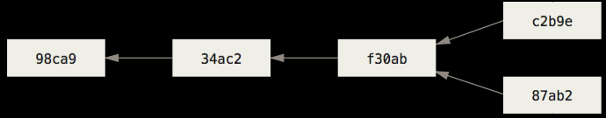
Git Branching
In other words, the commit graph can fork

Slide 12
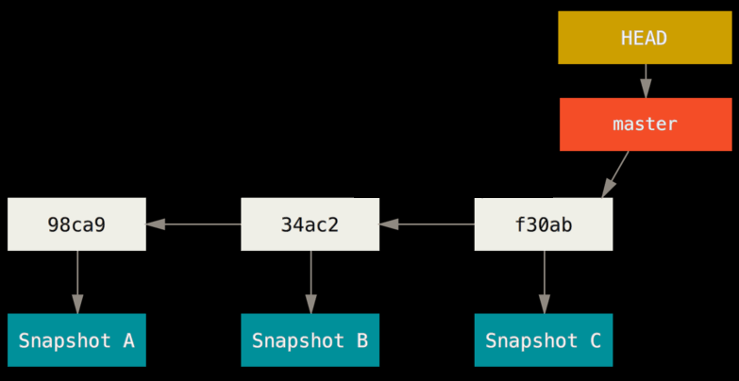
Git Branching
Labels, or pointers, are used to keep track of different branches in the repo
There is usually a master branch
This is just convention, though

Slide 13
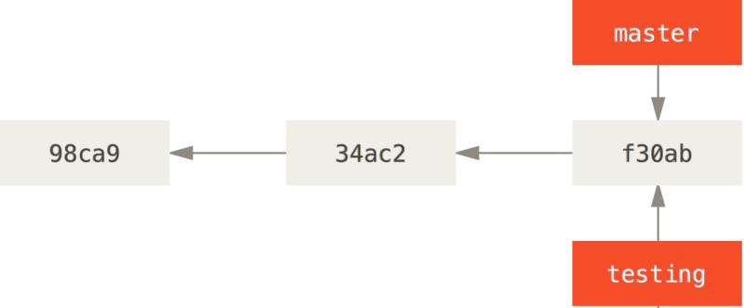
Git Branching
Important: the labels are often called “branches”
However, they’re different from the topological branches in the commit graph
Multiple labels can point to the same commit

Slide 14
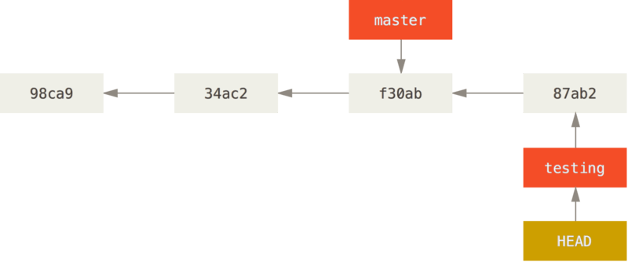
Git Branching
Commits are made to a particular branch
Automatically move the branch label

Slide 15
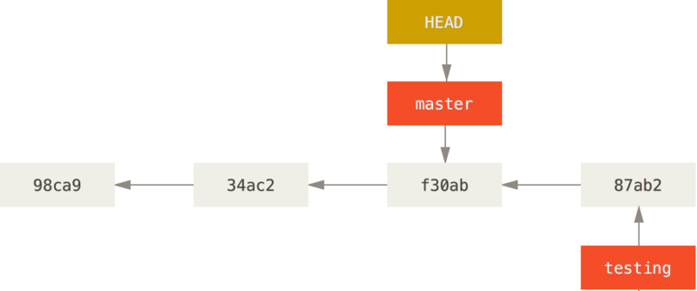
Git Branching
You can check out a different branch without altering the branch you currently have checked out

Slide 16
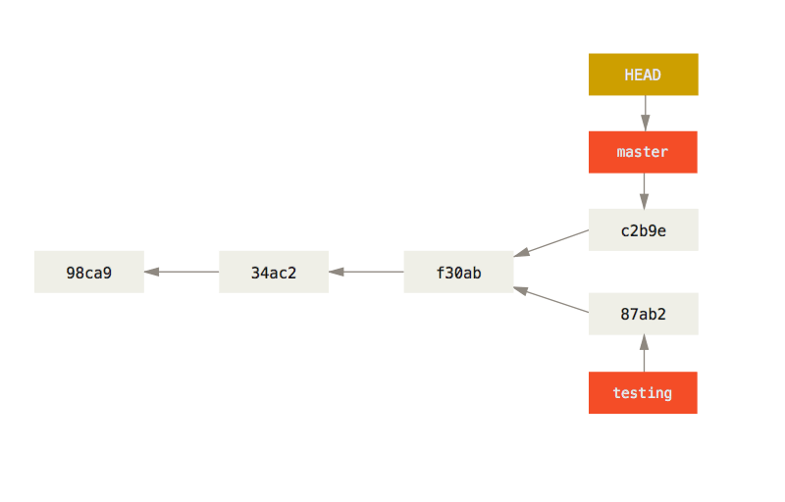
Git Branching
If different commits are made to two branches, the graph diverges

Slide 17
Git Merging
Often, you will want to merge branches
“The new feature is working, I want to bring it into master”
“The function I wrote for feature1 would be useful for feature2; I want it in the feature2 branch”
Basically, you want to take all or some of the changes in a branch, and copy them to a different branch

Slide 18
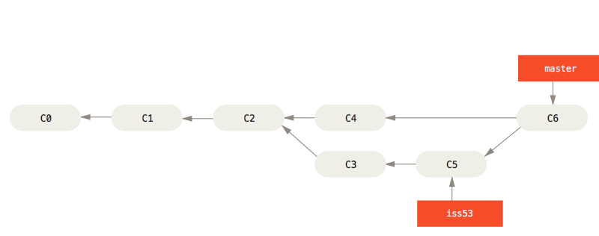
Git Merging

Slide 19
Git Merging
Git will automatically merge files if it can
Examples:
File was added in the source? Add file to target.
File was deleted in the source? Delete file from target.
Line was added to file in the source? Add line to file in target.
Line was changed in file in the source? Change line in file in target.
Potential problems arise when something was changed in the source and the target
I.e., there have been commits to both since they diverged
This is called a merge conflict

Slide 20
Git Merging
These files can be automerged:
# initialize the camera and stream
camera = PiCamera()
camera.resolution = (320, 240)
camera.framerate = 32
rawCapture = PiRGBArray(
camera,
size=(320, 240))
stream = camera.capture_continuous(
rawCapture,
format="bgr",
use_video_port=True)
fps = FPS().start()
# initialize the camera and stream
camera = PiCamera()
camera.resolution = (320, 240)
camera.framerate = 32
rawCapture = PiRGBArray(
camera,
size=(320, 240))
stream = camera.capture_continuous(
rawCapture,
format="bgr",
use_video_port=True)
fps = FPS().start()
# initialize the camera and stream
camera = PiCamera()
camera.resolution = (320, 240)
camera.framerate = 32
rawCapture = PiRGBArray(
camera,
size=(320, 240))
stream = camera.capture_continuous(
rawCapture,
format="bgr",
use_video_port=True)
print(“Sampling frames...")
fps = FPS().start()

Slide 21
Git Merging
These files cannot:
# initialize the camera and stream
camera = PiCamera()
camera.resolution = (320, 240)
camera.framerate = 32
rawCapture = PiRGBArray(
camera,
size=(320, 240))
stream = camera.capture_continuous(
rawCapture,
format="bgr",
use_video_port=True)
fps = FPS().start()
# initialize the camera and stream
camera = PiCamera()
camera.resolution = (320, 240)
camera.framerate = 25
rawCapture = PiRGBArray(
camera,
size=(320, 240))
stream = camera.capture_continuous(
rawCapture,
format="bgr",
use_video_port=True)
fps = FPS().start()
# initialize the camera and stream
camera = PiCamera()
camera.resolution = (320, 240)
camera.framerate = 60
rawCapture = PiRGBArray(
camera,
size=(320, 240))
stream = camera.capture_continuous(
rawCapture,
format="bgr",
use_video_port=True)
print(“Sampling frames...")
fps = FPS().start()

Slide 22
Git Merging
In these cases, a human needs to step in and decide which change is the “right” one

Slide 23
Git Remotes
So far, we’ve discussed how you manipulate a repository on your computer
How do we collaborate with other people?

Slide 24
Git Remotes
If Alice has a repo on her computer (and the networking is set up right), Bob can clone the repo
Make a complete copy of the entire history, all branches, etc.
Bob’s repo then considers Alice’s repo to be a remote

Slide 25
Git Remotes
A repo can have many remotes
The remote from which a repo was originally cloned is (usually) called origin

Slide 26
Git Remotes
After cloning, you can share changes with remotes in various ways

Slide 27
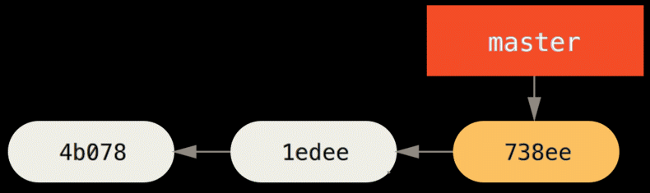
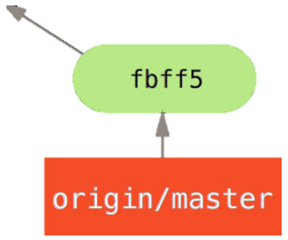
Git Remotes
The fetch command retrieves information about a branch (or all branches) from a remote
It does not change your copy of a branch
Just downloads information about the remote’s commits to your computer

Slide 28
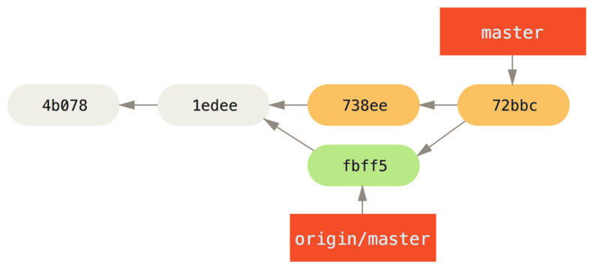
Git Remotes
Generally, you then want to merge the remote changes into your repo

Slide 29
Git Remotes
Since this is so common, the pull command combines the two
Literally just runs fetch followed by merge

Slide 30
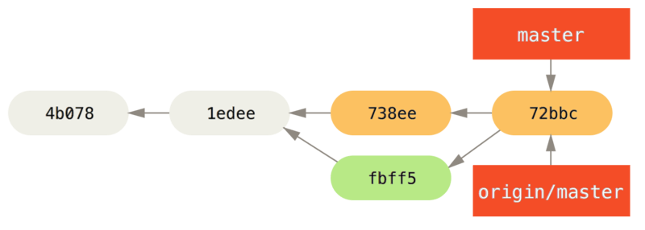
Git Remotes
In some cases (if the remote allows it), you can push commits to the remote
Otherwise, the remote can pull your changes

Slide 31
GitHub
GitHub basically provides two things:
A professionally-hosted place to use as a remote
A bunch of useful tools for managing repos and projects
GitHub is not in any way essential to using git
Serves as a central place for everyone to push their changes to

Slide 32
Good Practices
Use descriptive commit messages
Don’t say “Fixed the auto”
Say “Fixed race condition in turnToAngle function”
Make commits as atomic as possible
Don’t make one big commit “Sped up the code”
Make many individual commits: “Removed unnecessary loop”, “Switched to more efficient exponentiation”, “Implemented mergesort”, etc.

Slide 33
Good Practices
When you want to experiment, develop a new feature, or fix a bug, create a branch for it
Then merge into master when you’re done
Master should always be stable, working code

Slide 34
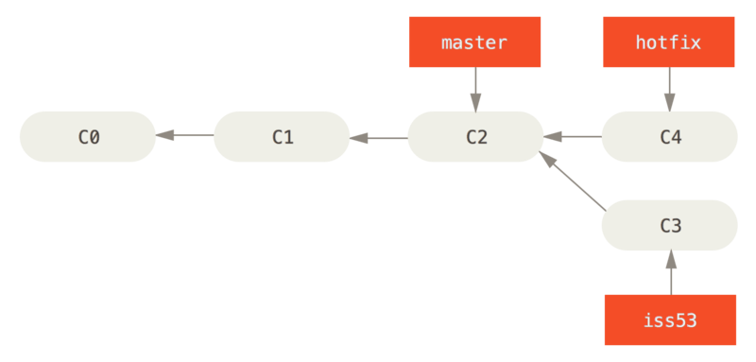
Good Practices
Sometimes a merge just moves a label
If the branch you’re merging into hasn’t had any changes since you branched
In these cases a fast-forward merge can be done

Slide 35
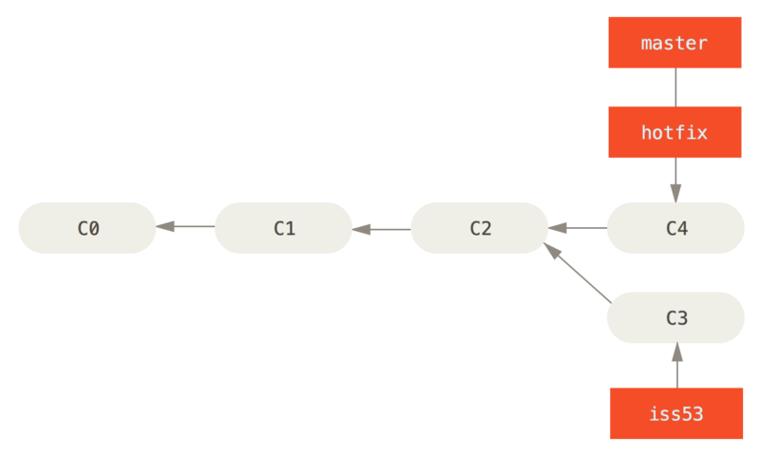
Good Practices
At least in robotics, please don’t do this
When someone’s looking at the repo history, it looks like those changes were made directly to master

Slide 36
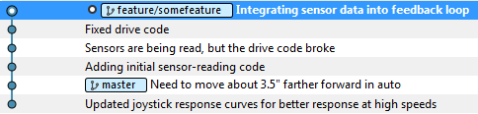
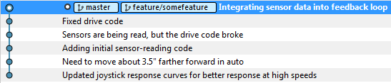
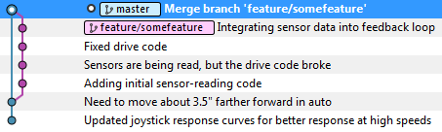
Good Practices
With fast-forward
Without fast-forward
This goes back to making sure that all commits on master are working code
With fast-forward, all the commits from the branch appear to be on master

Slide 37
Good Practices
Tags are basically static branch labels
They always point to the same commit
Useful for identifying particular commits with a name

